Slide 1

If a method is simple and straightforward
it does not need a design.
More complex methods should be
designed before construction.
JSP (Jackson Structured Programming)
notation can be used as the design language

Slide 2
argument(s)
returned
method
A method can have any number of arguments, but at most 1 thing returned.
pre-supplied
method
method
being developed

Slide 3
Sequence
go to
work
go to
station
take train
to terminus
take bus
to work

Slide 4
selection
go to
station
else
c1
c2
o
o
o
take a taxi
to station
run to
station
walk to
station
c1: if very late for train.
c2: if late for train.

Slide 5
iteration
take bus
to work
go to
sixth floor
*
c1
*
c2
wait for
next bus
walk up one
flight of stairs
c1: while bus not on correct route.
c2: six times.

Slide 6
exception handling
attempt to
go to work
?
p1
?
a1
assume
you can go
admit
you cannot
!
q1
p1: assume you can get to work.
a1: admit you can not get to work.
q1: explicit not going to work.
remember it
is sunday

Slide 7
cheese & onion
sandwitch
across or down?
slice of
bread
cheese & onion
sandwitch
layer of
onion
slice of
bread
layer of
onion
layer of
cheese
slice of
bread
layer of
cheese
slice of
bread

Slide 8
structure is everything
a
e
o
o
o
b
c
d
f
g
h
l
o
o
o
i
j
k
o
o
m
n
o
o
o
p

Slide 9
sequence, selection or iteration
a
e
o
o
b
c
d
*
*
*
f
g
h
l
*
o
m
n
o
o
o
p

Slide 10
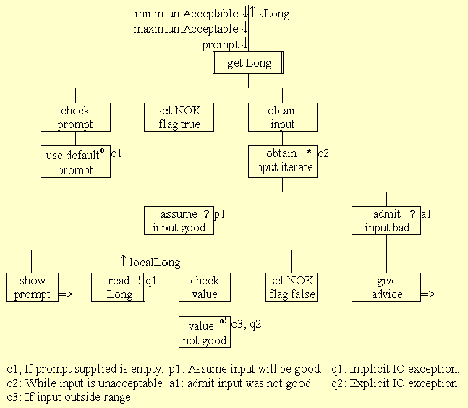

Slide 11
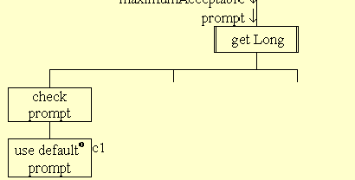
0012 public long readLong( String prompt,
0013 long minimumAcceptable,
0014 long maximumAcceptable){
0015
0016 long localLong = 0;
0017 boolean inputNotOK = true;
0018
0019 if ( prompt == null ) {
0020 prompt = new String( "Please enter an integer :");
0021 } // End if.
0022

Slide 12
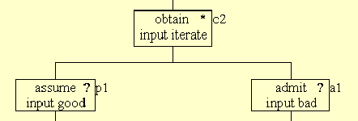
0023 while ( inputNotOK) {
0024 System.out.print( prompt);
0025 try {
0026 localLong = readLong();
0027 if ( (localLong < minimumAcceptable) ||
0028 (localLong > maximumAcceptable) ){
0029 throw new java.io.IOException();
0030 } else {
0031 inputNotOK = false;
0032 } // End if.
0033 } catch ( java.io.IOException exception) {
0034 System.out.println( "Please enter a value" +
0035 “between” + minimumAcceptable + " and " +
0036 maximumAcceptable + ".");
0037 } // End try/ catch;
0038 } // End while;
0039 return localLong;
0040 } // End readLong.

